Slide 1



Campus
Reopening
Guide
Higher Education Re-Opening Workgroup
Convened by:
  The State Board for Community and Technical Colleges
  The Council of Presidents
  The Independent Colleges of Washington

Slide 2
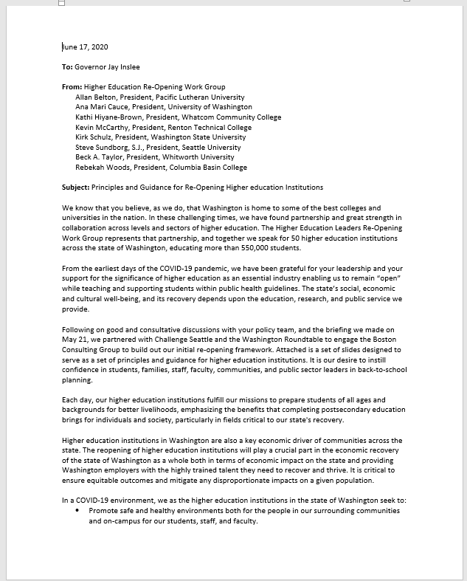
Principles and Guidance
Washington is home to some of the best colleges and universities in the nation. In these challenging times, we have found partnership and great strength in collaboration across levels and sectors of higher education. The Higher Education Leaders Re-Opening Work Group represents that partnership, and together we speak for 50 higher education institutions across the state of Washington, educating more than 550,000 students.

Slide 3
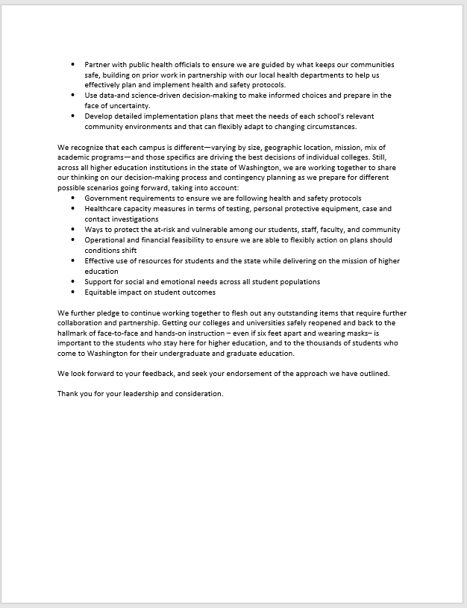
Principles and Guidance
Washington is home to some of the best colleges and universities in the nation. In these challenging times, we have found partnership and great strength in collaboration across levels and sectors of higher education. The Higher Education Leaders Re-Opening Work Group represents that partnership, and together we speak for 50 higher education institutions across the state of Washington, educating more than 550,000 students.

Slide 4
Context setting
Aligned statement & checklists
Why | Reason for development
  Instill confidence in key stakeholders about the development of higher education institutions' back-to-school plans in Washington
  Align how higher education institutions in Washington are approaching and developing back-to-school plans
How | Process for development
  Developed based on interviews with public health and university leaders in addition to incorporating effective practices seen globally
  Built off prior work including:
    Higher education institution work preparing for and executing reopening under the Governor's "Safe Start" measures
    Higher Ed Reopening Matrix developed by the Higher Ed Leaders Re-Opening Workgroup
    WA Private Sector Employer Checklists
    CDC and WA Labor & Industries guidelines
Who | People engaged for development
  We spoke with individuals from the organizations below and incorporated their input:
  Washington Council of Presidents
  Independent Colleges of Washington
  Washington State Community and Technical Colleges
  University of Washington reps.
  Washington State University reps.
  WA Student Achievement Council
  King County Public Health reps.
  Spokane County Public Health reps.
  Whitman County Public Health reps.
  WA Department of Health
  WA Labor & Industries
  WA Roundtable
  Challenge Seattle

Slide 5
Aligned statement from higher education institutions in Washington State (I/II)
The objective of this document is to serve as a set of guiding principles higher education institutions can align on to instill confidence in students, parents, staff, faculty, communities, and public sector leaders in back-to-school planning. These higher education institutions aim to fulfill their mission to prepare students of all ages and backgrounds for better livelihoods, emphasizing the benefits that completing college education brings for individuals and society, particularly in fields critical to our State's recovery. It is critical to ensure equitable outcomes and mitigate any disproportionate impacts on a given population. This document was developed in partnership with 50¹ higher education institutions in Washington State representing ~550k¹ students.
Higher education institutions in Washington are also a key economic driver of communities across the state. The reopening of higher education institutions will play a crucial part in the economic recovery of Washington State as a whole both in terms of economic impact on Washington State and providing Washington employers with the highly trained talent they need to recover and thrive.
In a COVID-19 environment, we as the higher education institutions in Washington State will seek to:
  Promote safe and healthy environments both for the people in our surrounding communities and on-campus for our students, staff, and faculty
  Partner with public health officials to ensure we are guided by what keeps our communities safe, building on prior work in partnership with our local health departments to help us effectively plan and implement health and safety protocols
  Use data- and science-driven decision-making to make informed choices and prepare in the face of uncertainty
  Develop detailed implementation plans that meet the needs of each school's relevant community environments and that can flexibly adapt to changing circumstances
From Jan Yoshiwara: SBCTC has 34 colleges with 100 locations, 360K students with 21K employees; From Terri Standish-Kuon: ICW has 10 campuses, 35K+ students, 8K+ employees; From Paul Francis: COP has 6 Institutions with >156K students

Slide 6
Aligned statement from higher education institutions in Washington State (II/II)
Across the higher education institutions in Washington State, we will work together to share our thinking on our decision-making process and contingency planning as we prepare for different possible scenarios going forward, taking into account:
  Government requirements to ensure we are following health and safety protocols
  Healthcare capacity measures in terms of testing, PPE, case and contact investigations
  Ways to protect the at-risk and vulnerable among our students, staff, faculty, and community
  Operational and financial feasibility to ensure we are able to flexibly action on plans should conditions shift
  Effective use of resources for students and the state while delivering on the mission of higher education
  Support for social and emotional needs across all student populations
  Equitable impact on student outcomes
We will also continue to work together to flesh out any outstanding items that require further collaboration and partnership.

Slide 7
Three forms of checklists to serve as guidance for higher education institutions in Washington state
Applies across the institution
Leveraged and built upon WA State reopening plan
& WA employer reopening checklists
Applies to specific campus settings
Leveraged and built upon CDC & other state guidance
      Baseline recommendations
      Additional considerations
      Setting-specific protocols
Broad checklist of how an institution can create a "New Normal" to fight COVID-19 that can be applied to a variety of higher education facilities and services
Optional considerations and examples that institutions can implement where feasible and relevant
Checklist of specific practices to mitigate risk, tailored to particular campus facilities/services: food services, transportation, residences
Higher education administrators have a strong incentive to meet (and exceed where/when appropriate) baseline recommendations as adverse public health outcomes could result in more stringent restrictions

Slide 8
For reference: Checklists developed using multiple sources
Baseline/Additional considerations
  Adjusted Washington Roundtable / Challenge Seattle "two tiered checklists for employer Safe Work Plans" for higher education context
Food services protocol
  Synthesized National Restaurant Association restaurant recommendations and Cushman and Wakefield food hall guidance
Campus transportation protocol
  Synthesized CDC and US Department of Transportation recommendations
Residences protocol
  Synthesized CDC recommendations for Shared or Congregate Housing and Correctional/Detention Facilities

Slide 9
Baseline recommendations for higher education institutions reopening plans
Institutions are developing Safe Back-to-School plans to resume operations with consideration of these critical elements
Campus Safety
Adhere to federal, state and local public health and safety guidelines; develop comprehensive plans for each phase of reopening in accordance with WA State guidelines and local health guidelines; make available a copy of these plans at each location on campus
Work from home for operations able to be performed remotely and institutions will follow WA State returning to work guidance for its personnel
Maintain minimum physical distancing whenever possible of 6 feet between all on-campus personnel, including with visitors; where physical distancing cannot be maintained, implement administrative or engineering controls to minimize exposure
Follow WA State phased reopening guidelines for gathering sizes
Ensure frequent and adequate hand washing policies and include adequate maintenance of supplies; use disposable gloves where safe/applicable to prevent transmission on shared items
Routine sanitization of high-touch surfaces and shared resources (e.g., doorknobs, elevators, vending machines, points of sales)
Ask students/personnel to self-certify that they have experienced no CV-19 symptoms since last visit to campus facility
Ask students/personnel to stay home and seek medical guidance if they are experiencing any known symptoms; remain isolated until diagnosis and next steps are clear
Ask students/personnel to self-quarantine per local public health guidelines if confirmed to have COVID-19 or exposed to confirmed case
  Please see supporting guidance from the WA State Department of Health: Click for link
Develop response protocols for students, personnel, and visitors reporting symptoms and/or are confirmed to have COVID-19
Avoid non-essential travel by school personnel and propose self-quarantine per local public health and worker safety guidelines after any high-risk travel as defined by the CDC (e.g., international travel); follow WA State reopening guidelines for travel
If feasible, log students, personnel (and visitors where possible); follow WA State guidelines for logging onsite personnel
Available contact for all students/personnel to report concerns and/or potential violations of the Safe Back-to-School Plan
Regular self-monitoring and updates of the Safe Back-to-School Plan
Communication of Safe Back-to-School Plan to all students and personnel including any future modifications
Designate specific spaces for isolating campus personnel and/or students on-campus as needed (e.g. specific building campus personnel and/or students can quarantine in)
Supporting a common
"New Normal" foundation
to mitigate COVID-19
The following checklist provides proposals for institutions of higher education in Washington State to reopen operations.
These actions will run in parallel to public health efforts.
Protecting Washingtonians through a safe reopening and acting as good stewards of our local communities is our priority.
Subject to change based on public health guidance.
Student/Personnel Support
Adhere to state and federal law for health and safety during COVID-19 including WA State's "Safe Start" guidelines and WA Labor & Industries guidelines
Provide students/personnel with PPE such as gloves, goggles, face shields, and masks as appropriate or required for students/personnel not working alone (e.g. any public-facing job and/or those whose responsibility includes operating within physical distancing limits of 6 feet; if PPE cannot be provided as appropriate shut down activity
  Note: Follow WA Labor and Industries guidelines for masks
Identify available alternative arrangements for students/personnel upon requests or refusals to work due to concerns related to campus safety. Priority should be given for students/personnel who are considered high-risk/vulnerable as defined by public health officials; Follow WA State guidelines for COVID-19 scenarios & benefits
Educate students/personnel on symptom detection, sources of high risk to COVID-19, prevention measures, and leave benefits/policies (e.g., UI for personnel that need to self-quarantine); follow any education requirements for employers per WA COVID-19 safety plan
Visitor Expectations
Limit or prohibit visitors
Visible entry point signage for students, personnel, and visitors on shared on-campus responsibilities (including proper hygiene & sanitization, physical distancing/PPE guidance and information for reporting concerns, staying home if feeling sick)

Slide 10
Additional considerations: Campus safety
Elements for institutions to consider & implement where feasible/relevant
Encouraging proper hygiene & health practices
  Encourage students/personnel to do regular temperature checks at home before coming to work
  Avoid non-essential person-to-person contact (e.g., handshakes)
Health screenings and testing
  Routine temperature checks & screens on-premise
  Work with Institutions within the same county to coordinate testing efforts
Enabling tracking and tracing
  Notify and isolate all students/personnel in contact with an individual that develops symptoms while maintaining confidentiality of those who are sick
  Disinfect areas where students/personnel who was sick touched
  Have the ability to log visitors that come on-campus
Sanitation procedures
  Provide hand sanitizer at entrances/exits
  Encourage personnel to wash hands regularly (after bathroom breaks, after eating, etc.)
  Provide disinfectant wipes
  Ensure frequent cleaning of high touch or shared equipment
  Sanitize/quarantine deliveries/packages
  Perform regular deep cleaning
  Provide soap and running water, when running water not available provide portable washing stations
Limiting shared resources
  Limit shared desks/workspaces
  Reduce use of shared office supplies/resources
  Limit shared food
  Limit cafeteria capacity and services
  Limit public kitchens/vending
Methods to enact distancing procedures
  Implement reduced maximum capacity limits
  Stagger arrivals into campus spaces to avoid congestion
  Limit ingress/egress points in campus buildings/facilities while maintaining fire exits
  Stagger entry into buildings/facilities
  One-way facility aisles
  Use distance markings at places of congregation
  Enact plexiglass protection between workstations
  Virtual meetings even when on campus
  Re-organize floor layouts to permit physical distancing
  Stagger usage of common areas
  Avoid sitting face-to-face
  Create isolated work cells/teams for on-campus personnel where possible
  Identify choke point and high risk areas where personnel typically congregate where distancing will need more control/monitoring
  To the extent practical, allow only one group/class at a time at the same location/lab/classroom.
Ensuring governance & accountable roles over plan
  Appoint team/lead to manage ongoing Safe Back-to-School Plan and monitor ongoing health of personnel at on-campus locations
  Designate a hygiene leader for facility who is responsible for protocol audits
  Regular reporting of student and personnel sentiment and tracking of public health trends
On-going training to meet health guidelines
  Host pre-return training and track attendance/completion
  Educate students/personnel in the language they understand best about coronavirus and how to prevent transmission and the institution's COVID-19 policies.
Helping develop
individualized, flexible
Safe Back-to-School Plans
Each individual institution will develop and implement a Safe Back-to-School Plan.
The following lists are considerations and examples to aid in the development of individual plans.
Note: Institutions are not recommended to implement all listed examples. These are provided as known practices being utilized to-date and are subject to change.

Slide 11
Additional considerations: Campus support
Elements for Institutions to consider & implement where feasible/relevant
Ongoing communication to workforce
  Provide content for vulnerable students/personnel to help navigate back-to-school (e.g. aggregate helpful materials, explain evolving gov't benefits)
Enacting modified working models for personnel
  Job shares that allow for reduced hours
  Offer partial workforce or alternate day of week operating model
  Different in-office working hours (e.g. two shifts: 6:30a-12:30p and 1p-7p with time between shifts)
Expanded / extended work from home & leave policies
  Provide one-time home office supply voucher
  Tiered PTO (e.g. FTEs get additional 80 hours; PTE get additional 40 hours; all paid out at year end if not used)
  Create workforce relief/aid fund and adopt policy on how funds will be distributed
  Create policies to encourage students/personnel to stay home when feeling sick or came into contact with positive case
Decreasing commute risks & pressure on public transport
  Promote and enable individual commutes (e.g., subsidized biking/parking)
  Institution-sponsored buses/transit options
  Alternative hours to limit transportation during high public traffic hours
Providing additional training and resources
  Provide guidance on virtual and in-person teams
  Provide career planning and resources
  Train staff to support new back-to-school model
  Post, in areas visible, required hygienic practices
Enabling access to education and childcare
  On-site day care or study rooms for limited number of children per day
  Voucher for online education tools
  Access to apps to match caregivers with need (including recently displaced workers)
  Priority for childcare for workers and students not able to WFH
Building morale and virtual culture
  Create virtual HR office hours and/or HR hotline
  Virtual companywide meetings
  Create networks for workers to connect/share remote working best practices
  Sponsor well-being challenges geared to staying physically and mentally healthy
Supporting mental health needs
  Access to reduced cost and/or free counseling
  Access to reduced cost and/or telemedicine consultations
  Benefit extensions for household members
  Access to meditation/mindfulness content
  Digital support groups to decrease isolation and share ideas
  Virtual play dates for families with children of similar ages
  Expand virtual health and counseling and continue to provide virtual options after reopening
Ensuring equitable outcomes
  Consider and mitigate any disproportionate impacts on a given population (e.g., due to instructional decisions)
Helping develop
individualized, flexible
Safe Back-to-School Plans
Each individual institution will develop and implement a Safe Back-to-School Plan.
The following lists are considerations and examples to aid in the development of individual plans.
Note: Institutions are not recommended to implement all listed examples. These are provided as known practices being utilized to-date and are subject to change.

Slide 12
Recommended protocols for food services to resume operations (1/2)
FOOD SERVICES
Supporting a common
“new normal” foundation
to mitigate COVID-19
Cleaning and sanitizing
  Complete thorough and detailed cleaning of entire facility, with focus on high-contact areas that would be touched by both students/personnel
  If relevant, consider single-use menus only; follow WA State phased reopening guidance for menus
  Make hand sanitizer readily available to workers and visitors at counters, tables and stations and consider touchless solutions
  Complete routine sanitization of high-touch surfaces and shared resources (e.g., door handles, points of sales)
  Use EPA-registered disinfectant products and avoid all food contact surfaces when using disinfectants
  Consider reducing facility hours for extra deep cleaning
  Cleaning staff wear disposable gloves and gowns for all tasks in the cleaning process, including handling trash
  When dining reopens, sanitize tabletops, booths, etc. between seatings
  Clean and sanitize restrooms regularly based on frequency of use once dining reopens
The following checklist provides recommendations for campus food services to reopen operations
These actions will run
in parallel to public
health efforts
Our priority is protecting campus communities in Washington by acting as good stewards
Subject to change based on public health guidance
Note: Must consider that food services on a campus will have regular visits and thus may be higher risk than a restaurant
Physical distancing
  Maintain physical distancing of 6 feet for extended periods of >15 minutes (e.g., students waiting in-line to enter facility, customers waiting for takeaway); PPE to be provided for all workers
  Require dining staff to wear face coverings; follow WA State reopening guidelines and WA Labor and Industries guidelines for masks
  Implement floor markings to promote physical distancing
  Post signs to remind students/personnel of physical distancing, PPE requirements and to use hand sanitizer
  Enforce capacity limits (e.g., enforced at point of entry with clickers); follow WA State reopening guidelines for restaurants
  Consider an exit from the facility separate from the entrance
  Manage employee schedules to allow for physical distancing whenever possible
  Where possible, workstations to be staggered so employees can avoid standing direct next to one another
  Limit the number of employees allowed simultaneously in any break rooms
  Update floor plans for common dining areas, redesigning seating arrangements to ensure to ensure physical distancing may be maintained between tables while visitors are eating once dining reopens
  Limit amount of time each patron is allowed to remain in order to reduce exposure
Source: National Restaurant Association COVID-19 Reopening Guidance, Cushman and Wakefield Recovery Readiness

Slide 13
Recommended protocols for food services to resume operations (2/2)
FOOD SERVICES
Employee health and personal hygiene
Supporting a common
“new normal” foundation
to mitigate COVID-19
  Require employees with COVID-19 symptoms to remain home until they are symptom-free for ten days and three days without medication (whichever longer)
  Ask employees to self-quarantine for 14-days from symptom onset or test positivity of the case per Washington public health guidelines if confirmed to have COVID-19 or exposed
  Provide employees with face coverings and keep face coverings clean and ask employees to follow 6 ft distancing guidelines; follow WA State reopening guidelines and WA Labor and Industries guidelines for masks
  Train all employees on the importance of frequent handwashing, the use of hand sanitizers with at least 60% alcohol content, and give them clear instruction to avoid touching hands to face
  Educate workers in the language they understand best about coronavirus and how to prevent transmission, and the institution's COVID-19 policies
The following checklist provides recommendations for campus food services to reopen operations
These actions will run
in parallel to public
health efforts
Our priority is protecting campus communities in Washington by acting as good stewards
Subject to change based on public health guidance
Note: Must consider that food services on a campus will have regular visits and thus may be higher risk than a restaurant
Facility safety
  Have the ability to log all workers that come on premise for purposes of supporting public health contact tracing by the WA DOH
  Check appropriate functioning of HVAC
  Ask workers resuming on-premise work to confirm they have not experienced symptoms for 14 days from symptom onset or test positivity of the case prior to return
  Restrict cash payments; allow payments only by card or contactless
  Consider use of pre-rolled, disposable silverware if possible
  Ensure adequate storage of necessary materials to meet PPE and cleaning requirements
  Communicate safety protocols to all workers and dining visitors, including available contact to report violations of protocols
  If offering delivery options, ensure coolers and transport containers are sanitized and encourage customers to use "no touch" deliveries
Customer expectations
  Visible entry point signage for workers, volunteers and visitors on shared responsibilities (including proper hygiene and sanitization, physical distancing, PPE guidance and information for reporting concerns,)
  Require or strongly encourage all patrons to wear cloth face coverings
  Make visitor safety guidelines publicly available
  Consider using social media or website to educate students/personnel on food service protocols and what to expect in dining halls
Student/personnel support
  Adhere to state and federal law for health and safety during COVID-19 including WA State's "Safe Start" guidelines and WA Labor & Industries guidelines
  Mitigate anxiety by recognizing fear in returning, communicating transparently, listening and surveying students/personnel regularly
  Provide early reopening communication by keeping workforce informed as soon as appropriate
  Reinforce training after Day One by providing ongoing methods of additional training to reinforce messaging and changes
  Ensure any student/employee can follow on-campus student health specific guidelines before returning to work and while working
Source: National Restaurant Association COVID-19 Reopening Guidance, Cushman and Wakefield Recovery Readiness

Slide 14
Recommended protocols for campus transportation to resume operations (1/2)
TRANSPORTATION
Supporting a common
“new normal” foundation
to mitigate COVID-19
Cleaning and sanitizing
  After each journey, complete thorough and detailed cleaning of all surfaces, with focus on high-contact areas that would be touched by both employees and passengers (e.g., handles, metal bars)
  Make hand sanitizer readily available and create frequent opportunities for employees to wash their hands
  Provide disposable disinfectant wipes on buses, etc. and train employees on how to regularly clean the area
  Use EPA-registered disinfectant products
  Consider reducing operating hours for extra deep cleaning
  Cleaning staff wear disposable gloves and gowns for all tasks in the cleaning process, including handling trash
  Clean and sanitize restrooms regularly based on frequency of use
The following checklist provides adaptations for campus transportation, if applicable, to resume operations
These actions will run
in parallel to public
health efforts
Our priority is protecting campus communities in Washington by acting as good stewards
Subject to change based on public health guidance
Physical distancing
  Institute measures to physically separate employees from passengers by a distance of 6 feet or greater (e.g., physical partitions for drivers)
  Consider limiting capacity based on size of vehicle (e.g., 50%)
  Ask passengers to maintain physical distancing of 6 feet and face masks worn by all employees and passengers; Follow WA Labor and Industries guidelines for masks
  Implement floor markings to promote physical distancing on board
  Post signs for passengers to remind them of physical distancing, face covering requirements and to use hand sanitizer
  Limit contact between employees and passengers as much as possible
  Consider designating specific doors for entry only and others for exit only to minimize passenger contact
  Manage employee schedules to allow for physical distancing whenever possible
  Consider closing off every other seat on board with tape or signs to promote physical distancing
  Encourage employees and passengers to avoid congregating in waiting areas and design a process to ensure all stay separate while waiting to board (e.g., outdoor distancing)
Source: CDC, US Department of Transportation

Slide 15
Recommended protocols for campus transportation to resume operations (2/2)
TRANSPORTATION
Employee health and personal hygiene
Supporting a common
“new normal” foundation
to mitigate COVID-19
  Require employees with any COVID-19 symptoms to remain home until they are symptom-free for ten days and three days without medication (whichever longer)
  Require employees to self-quarantine for 14-days from symptom onset or test positivity of the case per Washington public health guidelines if they have been exposed to COVID-19
  Provide employees with face masks and keep face masks clean; Follow WA Labor and Industries guidelines for masks
  Train all employees on the importance of frequent handwashing, the use of hand sanitizers with at least 60% alcohol content, and give them clear instruction to avoid touching hands to face
  Train all employees on symptom detection, sources of high risk to COVID-19, prevention measures and leave benefits/policies
The following checklist provides adaptations for campus transportation, if applicable, to resume operations
These actions will run
in parallel to public
health efforts
Our priority is protecting campus communities in Washington by acting as good stewards
Subject to change based on public health guidance
Vehicle safety
  Have the ability to log all employees that come on board for purposes of supporting public health contact tracing by the Washington Department of Health
  Check appropriate functioning of HVAC
  Ask workers resuming work to confirm they have not experienced symptoms for 14 days from symptom onset or test positivity of the case prior to return
  Ensure adequate storage of necessary materials to meet PPE (face masks, gloves, etc.) and cleaning requirements
  Communicate safety protocols to all employees and passengers, including available contact to report violations of protocols
  Consider using no-touch trash receptables if possible
Passenger expectations
  Implement signs on board for employees and passengers on shared responsibilities (including proper hygiene and sanitization, physical distancing, face coverings and information for reporting concerns)
  Make passenger safety guidelines publicly available and post signs to strongly encourage passengers to wear face coverings
  Consider using social media or website to educate passengers on safety protocols and what to expect when on board
  Place signs at the entrance stating how passengers and employees can prepare to be on board
Employee support
  Adhere to state and federal law for health and safety during COVID-19 including WA State's "Safe Start" guidelines and WA Labor & Industries guidelines
  Mitigate anxiety by recognizing fear in returning, communicating transparently, listening and surveying employees regularly
  Provide early reopening communication by keeping workforce informed as soon as appropriate
  Reinforce training after Day One by providing ongoing methods of additional training to reinforce messaging and changes
  If employees have children, provide support in navigating childcare options when returning to work
  Ensure any employees can follow on-campus student specific health guidelines before returning to work and while working
  If employees refuse to work due to COVID-19 related safety concerns, provide high risk individuals with benefits per WA Proclamation 20-46
Source: CDC, US Department of Transportation

Slide 16
Recommended protocols for campus residences to resume operations (1/2)
RESIDENCES
Cleaning and sanitizing
Supporting a common
“new normal” foundation
to mitigate COVID-19
  Complete thorough and detailed cleaning of entire facilities, with focus on high-contact areas
  Make hand sanitizer readily available to residents/personnel throughout property; consider touchless hand sanitizing solutions
  Complete routine sanitization of high-touch surfaces (e.g., door handles, elevators, counters, etc.)
  Provide residents with their own sanitation solutions or wipes to instill confidence
  Disinfect all hard surfaces with an EPA registered chemical disinfectant
  If a student or residential staff member tests positive, close off areas used by sick person and wait 24 hours before cleaning and disinfecting; remove staff members who test positive and quarantine
  Conduct frequent cleaning of shared facilities (e.g., lounges)
  For shared bathrooms, create a cleaning schedule to clean facilities regularly; provide and maintain adequate handwashing supplies and hand sanitizer
  For shared showers, encourage sanitizing between users and/or increasing frequency of cleaning
The following checklist provides adaptations for campus residences to resume operations
These actions will run
in parallel to public
health efforts
Our priority is protecting campus communities in Washington by acting as good stewards
Subject to change based on public health guidance
Physical distancing
  Maintain signage to remind groups to stand at least 6 feet apart and avoid congregating in common areas
  Note: Follow WA Labor and Industries guidelines for masks
  Roommates and suitemates treated as a family unit; assign students with pre-existing health conditions to singles
  Consider installing plexiglass partitions in areas where residential staff and residents come into close contact (e.g., mail desks)
  Implement floor markings to promote physical distancing (e.g., where to stand in line, where to walk)
  Manage staff schedules to allow for physical distancing whenever possible in staff spaces
  For shared bathrooms, create a staggered bathroom schedule to reduce the amount of people using the facilities at the same time
  For shared showers, consider assigning residents to specific showers or limiting use of showers to every other stall
  Designate specific residence halls or buildings to isolate students/staff for quarantine or isolation periods as needed
Staff health and personal hygiene
  Require staff with COVID-19 symptoms to remain home until they are symptom-free for ten days and three days without medication (whichever longer)
  Ask staff to self-quarantine for 14-days from symptom onset or test positivity of the case per Washington public health guidelines if confirmed to have COVID-19 or exposed
  Provide employees with face coverings and keep face coverings clean – follow WA reopening guidelines and WA Labor and Industries guidelines for masks
  Train all staff on the importance of frequent handwashing, the use of hand sanitizers with at least 60% alcohol content, and give them clear instruction to avoid touching hands to face
  Educate workers in the language they understand best about coronavirus and how to prevent transmission, and the institution's COVID-19 policies.
Source: CDC, US Shared or Congregate Housing; CDC, US Correctional and Detention Facilities, Association of College & University Housing Officers-International, Other State's Guidance
Notes:
https://www.cdc.gov/coronavirus/2019-ncov/community/shared-congregate-house/guidance-shared-congregate-housing.html
https://www.cdc.gov/coronavirus/2019-ncov/community/correction-detention/guidance-correctional-detention.html
For bathrooms:
https://www.acuho-i.org/Portals/0/doc/blogNEWS/FOH.COVIDChecklist.pdf
https://doh.sd.gov/documents/COVID19/COVID19_Hotel_Lodging_checklist.pdf
https://www1.nyc.gov/assets/doh/downloads/pdf/imm/guidance-for-homeless-shelters-covid19.pdf

Slide 17
Recommended protocols for campus residences to resume operations (2/2)
RESIDENCES
Supporting a common
“new normal” foundation
to mitigate COVID-19
Facility safety
  All staff and residents must wear face masks throughout the building (exception for residents within their own rooms)
  When possible, rooms should remain vacant for 48 hours after check-out and prior to cleaning
  Have the ability to log all staff and residents that come on-premise for purposes of supporting public health contact tracing
  Ask workers resuming on-premise work to confirm they have not experienced symptoms for 14 days from symptom onset or test positivity of the case prior to return
  Communication of Safe Back-to-School Plan to all staff and residents, including available contact to report violations
  Use no-touch trash cans where possible on the property
  Check appropriate functioning of HVAC
  Symptomatic residents should avoid contact with other – follow DOH guidelines for individuals with symptoms
  Develop plan for how suspected COVID-19 cases will be isolated, evaluated, tested, and provided necessary wraparound services (e.g., medical care, food)
  Ensure that physical locations have been identified to isolate confirmed COVID-19 cases, and consider designating one staff member to attend to sick residents
  Create and test communications plans to disseminate critical information to residents/staff
The following checklist provides adaptations for campus residences to resume operations
These actions will run
in parallel to public
health efforts
Our priority is protecting campus communities in Washington by acting as good stewards
Subject to change based on public health guidance
Resident expectations
  Visible entry point signage for all staff and residents on shared responsibilities (including proper hygiene & sanitization, physical distancing, PPE guidance and information for reporting concerns)
  Make safety guidelines publicly available
  Consider using social media and website to educate residents on protocols and what to expect when entering on-campus housing facilities (e.g., digital check-in requirements)
  Remind residents of any quarantine requirements as defined by the local health jurisdiction and instruct them that compliance will be monitored
Employee support
  Adhere to state and federal law for health and safety during COVID-19 including WA State's "Safe Start" guidelines and WA Labor & Industries guidelines
  Mitigate anxiety by recognizing fear in returning, communicating transparently, listening and surveying staff regularly
  Provide early reopening communication by keeping workforce informed as soon as appropriate
  Reinforce training after Day One by providing ongoing methods of additional training to reinforce messaging and changes
  Ensure staff that live in residence halls can follow all resident health/safety protocols (e.g. quarantining upon arrival)
Source: CDC, US Shared or Congregate Housing; CDC, US Correctional and Detention Facilities
Notes:
https://www.cdc.gov/coronavirus/2019-ncov/community/shared-congregate-house/guidance-shared-congregate-housing.html
https://www.cdc.gov/coronavirus/2019-ncov/community/correction-detention/guidance-correctional-detention.html

